Slide 1
Podcast
By the Lads and the Gang
Also by cultured gentlemen

Slide 2
Podcast Topics
Games
Shows
Movies
Childhood
Camerons Issues
Guests

Slide 3
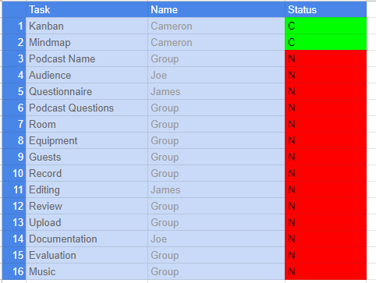
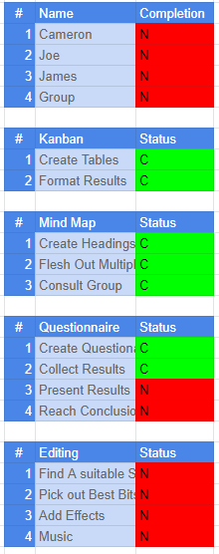
KanBan
To make are kanban we used google sheets for convenience and we have been slowly working our way through our list of assigned tasks

Slide 4
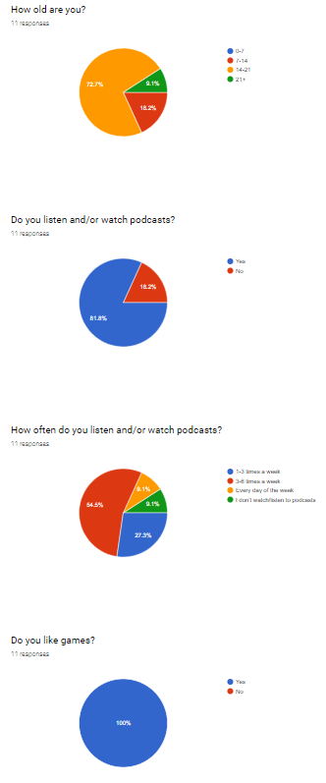
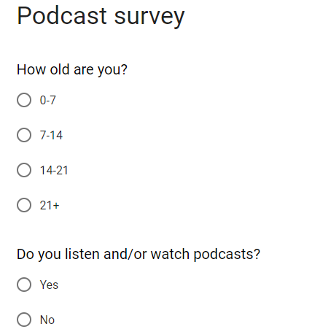
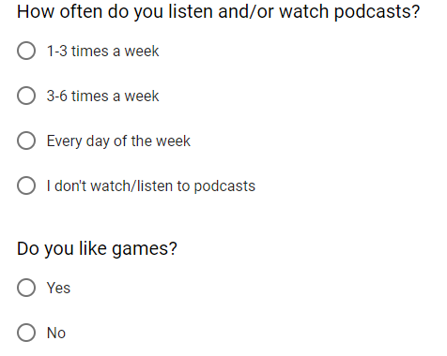
Work so far
So far we have created the group KANBAN, Mind map and have discussed ideas for our podcast, we have also created a questionnaire and have received responses.

Slide 5
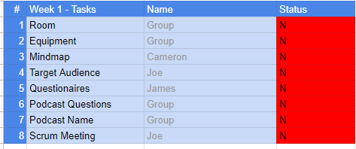
Work we’ll do today
Today we are hoping to be able to have a Podcast Name And as well as have questions for our podcast ready we are also going to use our questionnaires results to find our target audience

Slide 6
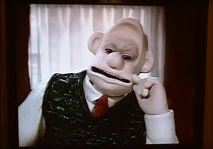
Work for next week
Our plan for next week is to find a room to record our podcast sessions and to also find equipment. We also plan to get some questions ready for the podcast.

